Slide 1
A Survey of Encoding Techniques for Signal Processing in Spiking Neural Networks
Shavika Rastogi | Sami Arja
Weekly Journal Club
10/11/2021
​
​

Slide 2


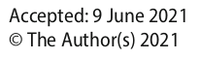
Why we chose this paper?
Why this paper is important?

Slide 3
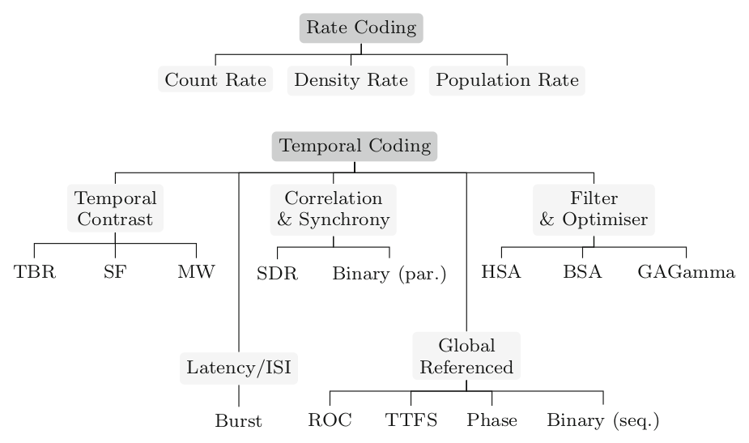

Slide 4

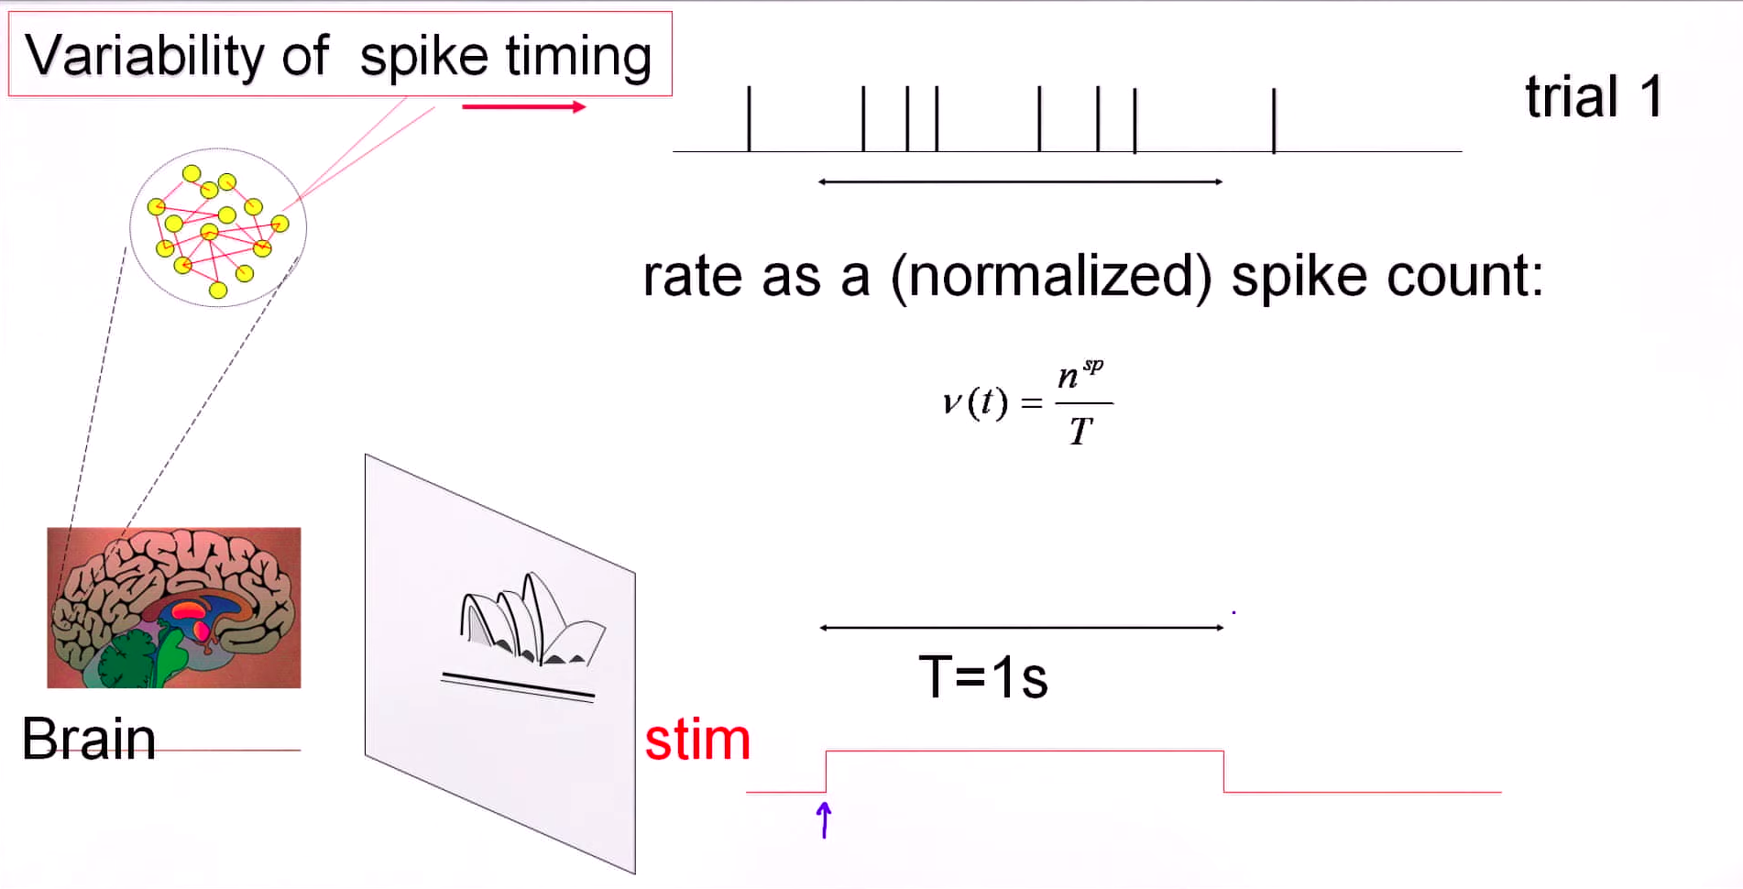
Count Rate
Notes:
Counting the number of spikes and divide by the stimulus time.
To evaluate the rate you have measure single neuron for single trial and average over time. The measures interval should be long enough
Slow and not biologically plausible

Slide 5
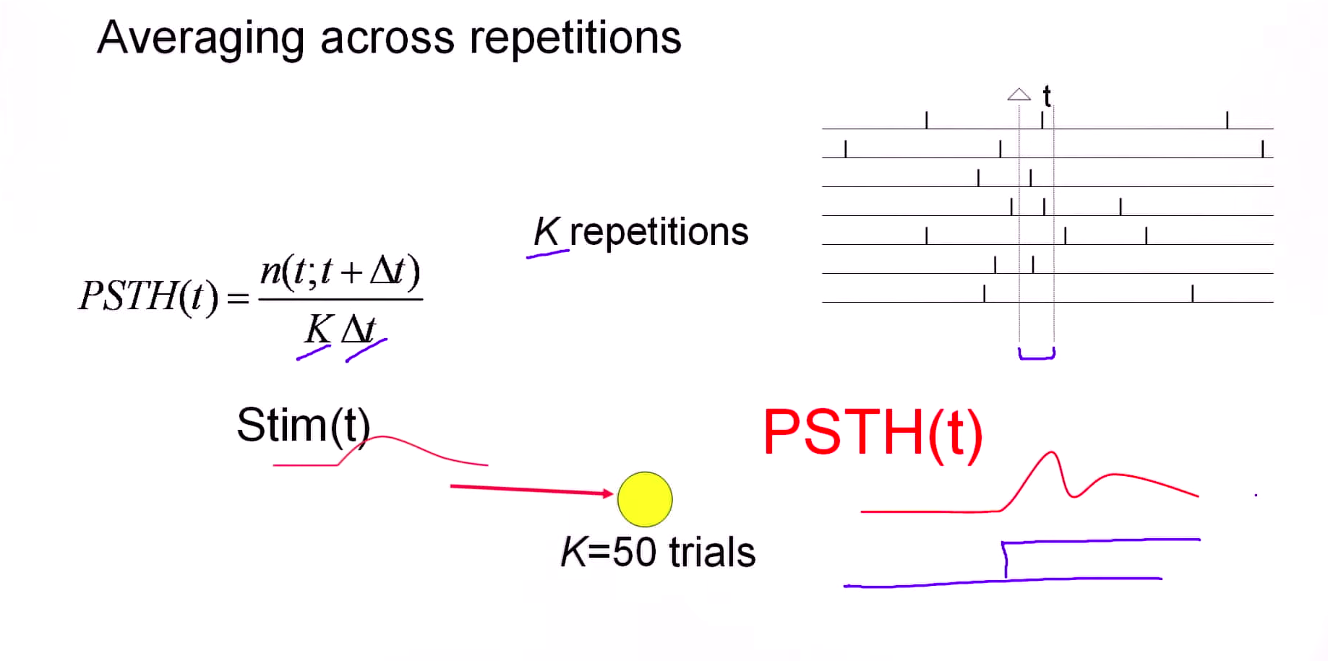
Density Rate
Single Neuron
Trial 1
Trial 2
Trial 3
Trial 4
Trial 5
Trial 6
Trial 7
Notes:
Counting the number of spikes and divide by the stimulus time.
To evaluate the rate you have measure single neuron for single trial and average over time. The measures interval should be long enough
Slow and not biologically plausible

Slide 6
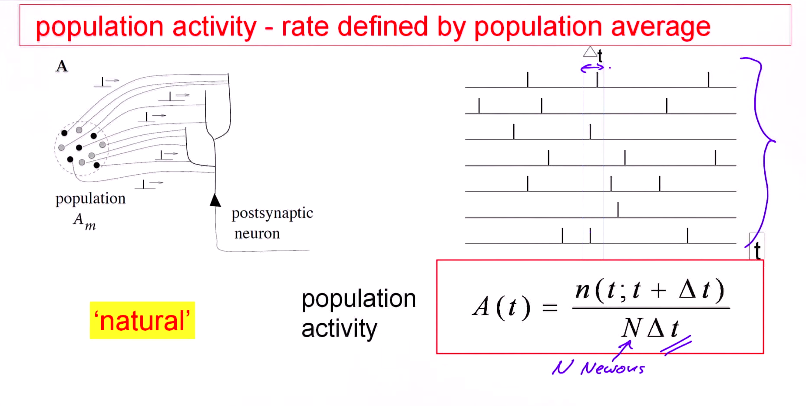
Population Rate
Neuron 1
Neuron 2
Neuron 3
1 Trial
Neuron 4
Neuron 5
Neuron 6
Neuron 7
Notes:
Counting the number of spikes and divide by the stimulus time.
To evaluate the rate you have measure single neuron for single trial and average over time. The measures interval should be long enough
Slow and not biologically plausible

Slide 7
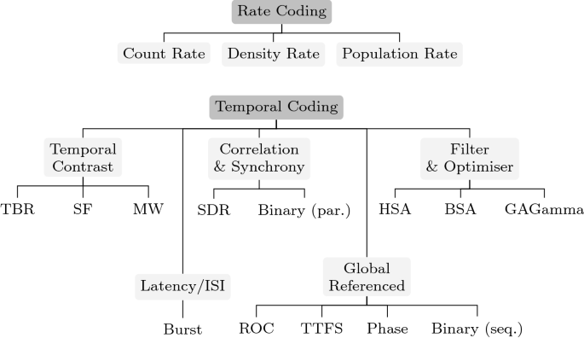

Slide 8
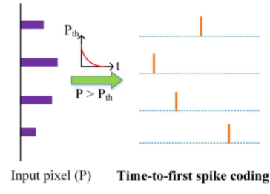
TTFS Coding
Encodes information using time difference between stimulus onset and the first spike of neuron
Observed in human tactile system and retinal pathway

Slide 9
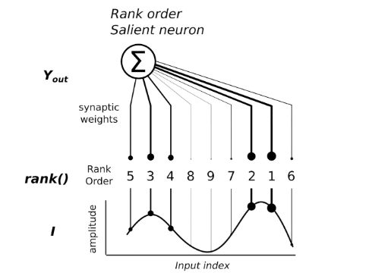
Rank Order Coding
Based on firing order of a population of neurons with respect to a global reference.
Observed in Retinal Ganglion Cells (RGC) for encoding spatial information in visual scenes. *
* Portelli et al. (2016), “Rank Order Coding : a Retinal Information Decoding Strategy Revealed by Large-Scale Multielectrode Array Retinal Recordings”

Slide 10
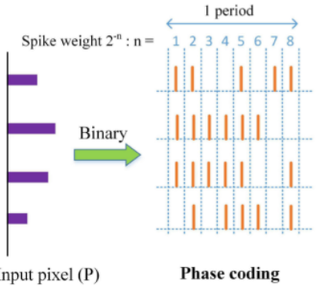
Phase Coding
Encodes information in the relative time difference between spikes and a reference oscillation.
Observed in neurons in cat’s visual cortex.

Slide 12
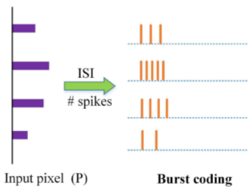
Burst Coding
Sends the burst of spikes at a time.
Observed in Thalamocortical neurons *
* Zeldenrust et al. (2018), “Spike and burst coding in thalamocortical relay cells”

Slide 13
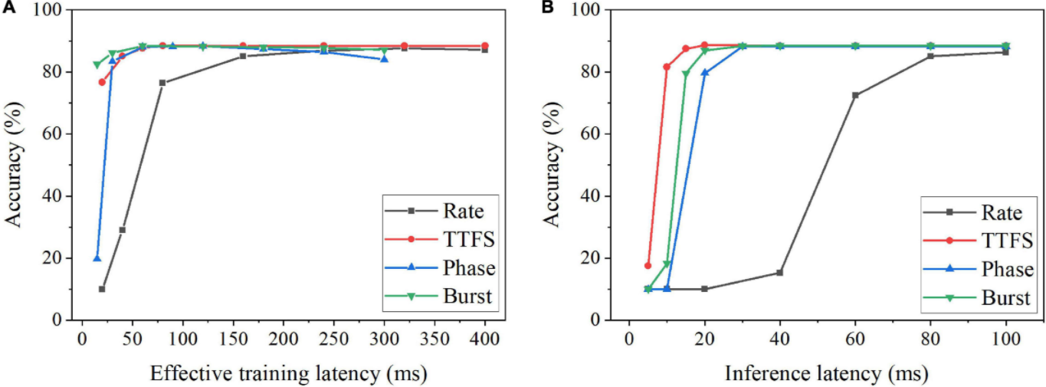
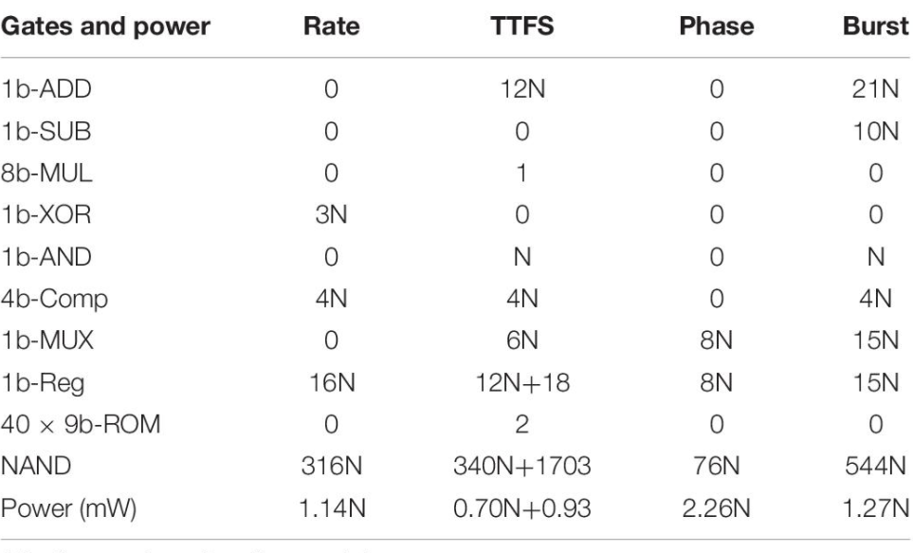
MNIST Example
Guo et al. (2021) “Neural Coding in Spiking Neural Networks : A Comparative Study for Robust Neuromorphic Systems”

Slide 14
Different Criteria to select a Spike Encoding method
Biological Plausibility
Training Latency
Inference Latency
Robustness to noise
Ease of implementation on hardware (Area Occupied).
Power Consumption on hardware.

Slide 16
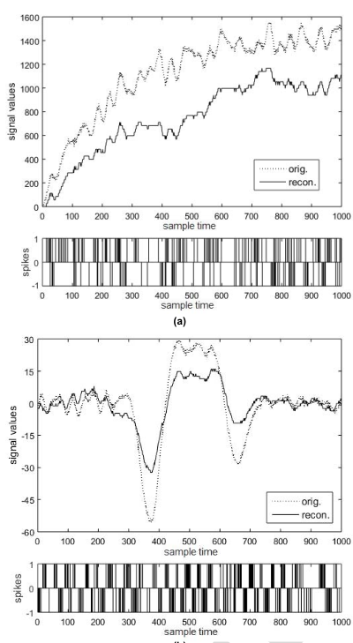
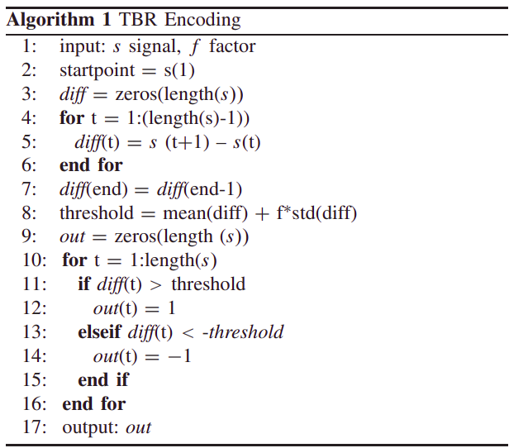
TBR Encoding
Scaling error of a trended signal
Compares the absolute signal change of an input signal with a threshold
Determined by the signal
characteristics
Fail to represent signal with different amplitude
To calculate
the threshold, the whole sample length is taken into account
Petro el al. 2020 (Selection and Optimization of Temporal Spike Encoding Methods for Spiking Neural Networks)

Slide 17
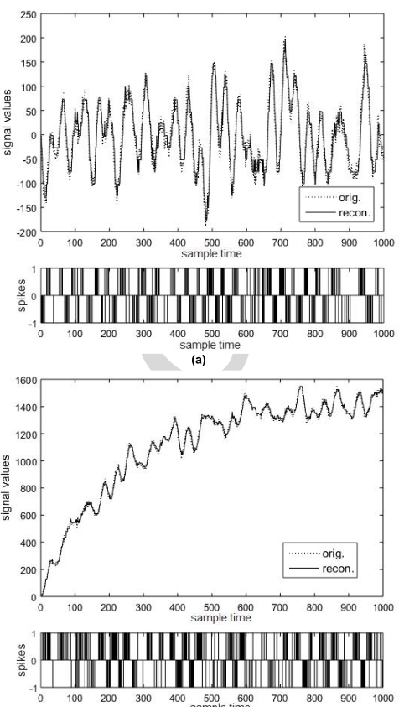
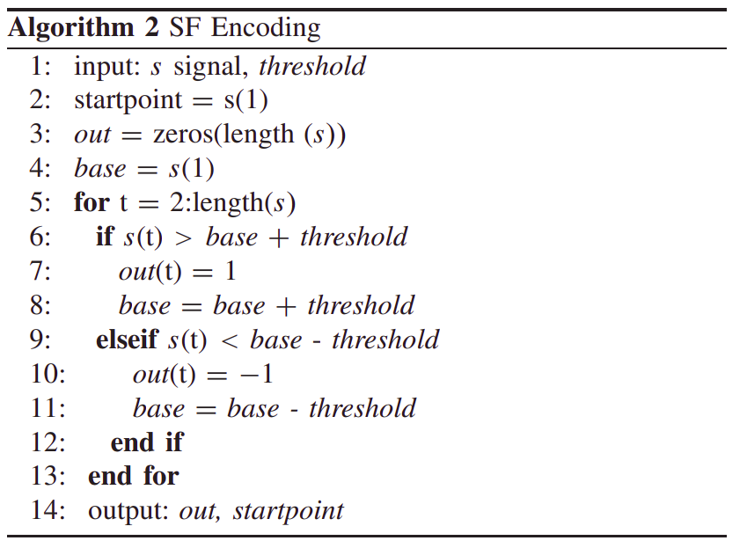
SF Encoding
Uses the next available signal value and checks if the previous value (base) and an additional threshold is exceeded
Spike sequence generated by SF represents a trended signal well
Only one parameter
Moving baseline
Petro el al. 2020 (Selection and Optimization of Temporal Spike Encoding Methods for Spiking Neural Networks)

Slide 18
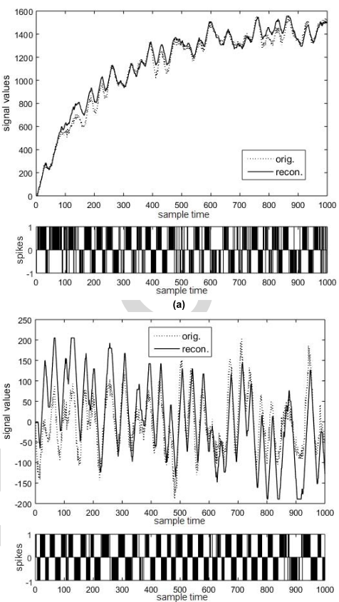
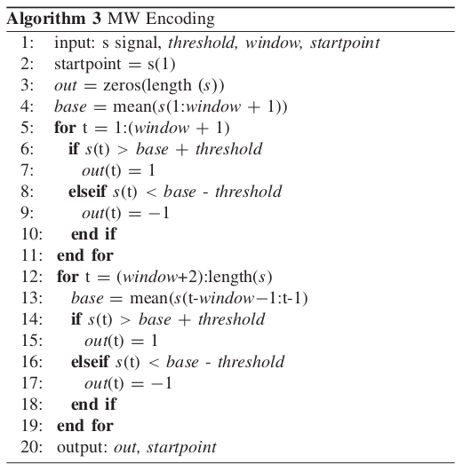
MW Encoding
MW follows a trended and smooth signal
Uses a base which is defined by the mean of the previous signal in a time window
Take two parameters
Noise and sharp peak are reduced
Moving baseline == moving average filter
Petro el al. 2020 (Selection and Optimization of Temporal Spike Encoding Methods for Spiking Neural Networks)

Slide 19
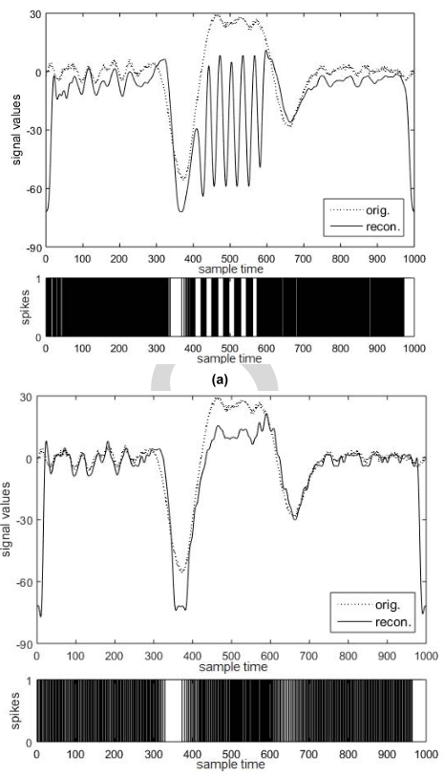
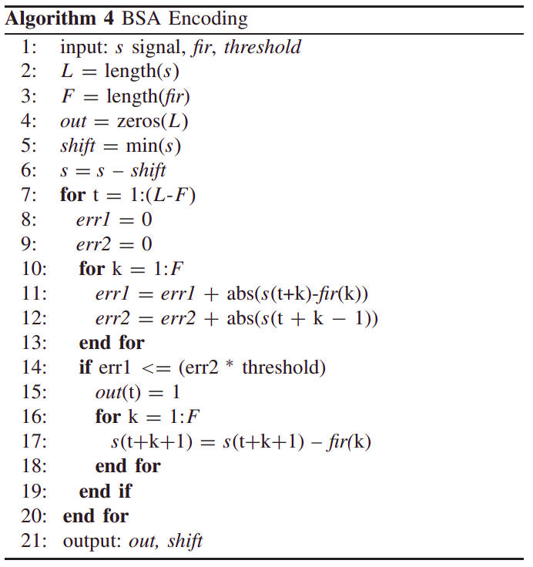
BSA Encoding
Makes the decision to spike comparing an errors measure to a threshold, but can only process inputs of a specific range
Error at high platea with poorly scaled coefficient
Take two parameters
At each timstamp an error is calculated
High plateau error disapears with well-scaled coefficients
Produce unipolar events
Petro el al. 2020 (Selection and Optimization of Temporal Spike Encoding Methods for Spiking Neural Networks)

Slide 20
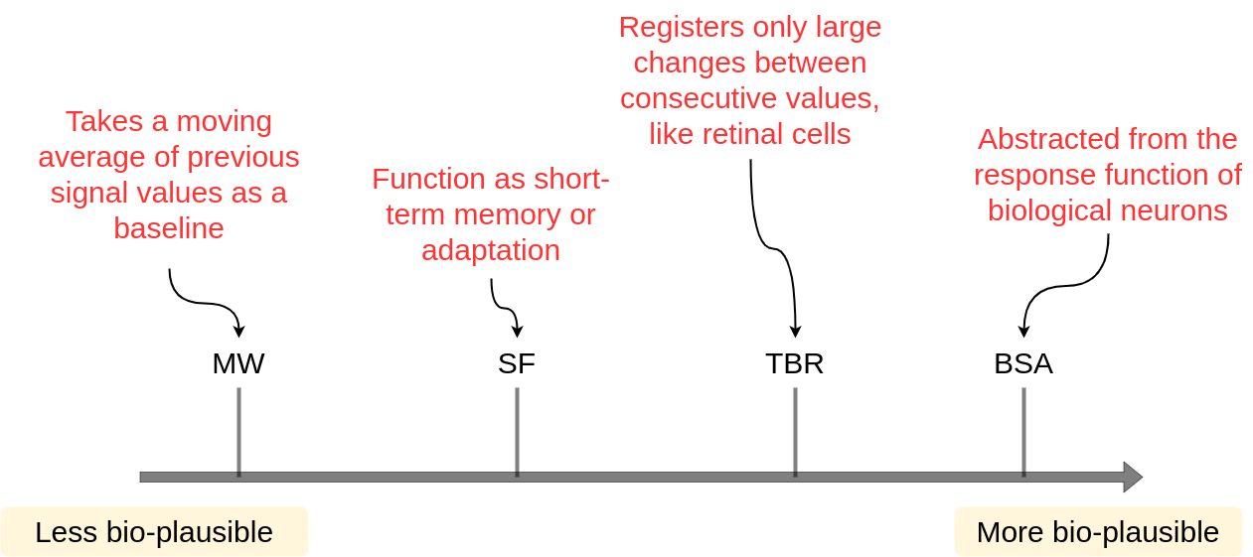
Observations on Biological Plausibility for Temporal Coding

Slide 21
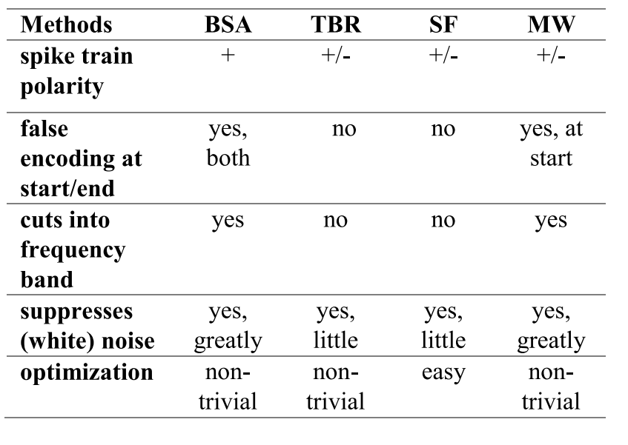
Summary and Comparison of Encoding Methods

Slide 23
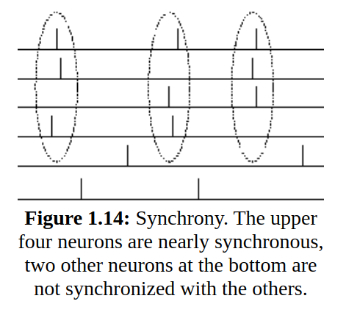
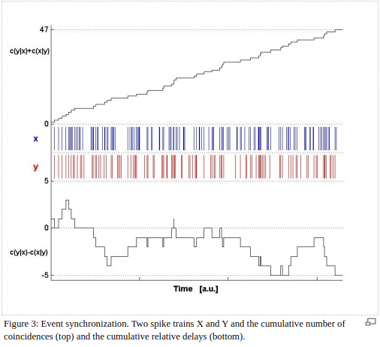
Correlation and Synchrony
The number of appearances of a spike in X shortly after a spike in Y
N1
N2
N3
‘Belonging together’
N4
N5
N6
http://www.scholarpedia.org/article/Measures_of_spike_train_synchrony
https://lcnwww.epfl.ch/gerstner/SPNM/node8.html

Slide 24
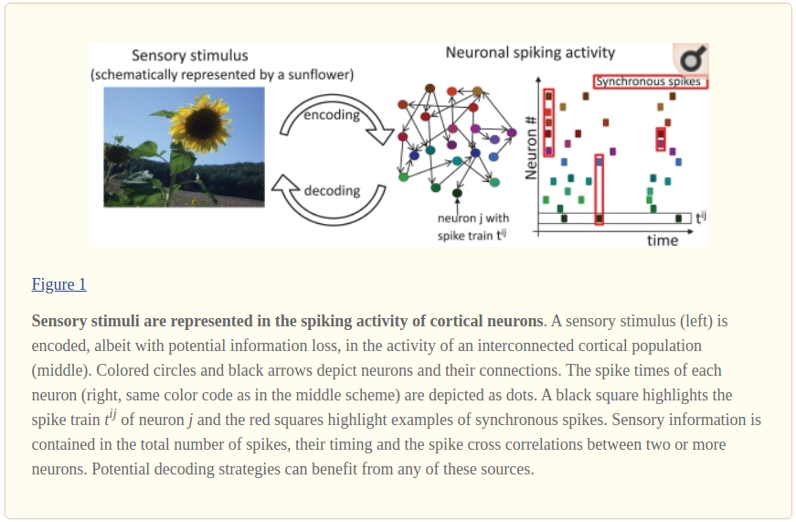
Correlation and Synchrony
spike groups with a relative short ISI represent specific input patterns
Tchumatchenko el al. 2011 (Spike Correlations – What Can They Tell About Synchrony?)

Slide 25
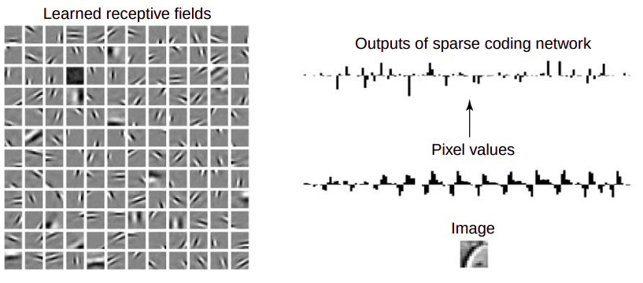
Sparse distributed representations (Sparse Coding)
In the extreme case, only one single neuron is
active at any given time
Olshausen el at. 2004 (Sparse coding of sensory inputs)

Slide 27
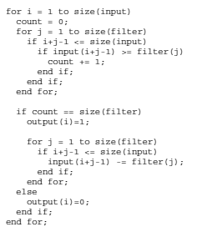
HSA Encoding
Does reverse convolution of the stimulus.
Filter is found by minimizing mean square error between estimated stimulus and reconstructed stimulus.
Comparison of shifted input with impulse response of filter
Spike will be emitted wherever shifted input is greater than impulse response of filter

Slide 28
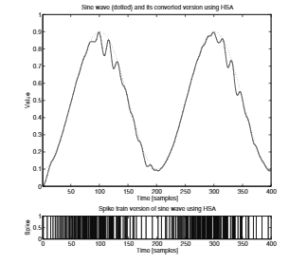
Sine Wave Example for HSA
Schrauwen et al. (2003) “BSA, a Fast and Accurate Spike Encoding Scheme”

Slide 29
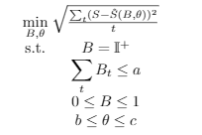
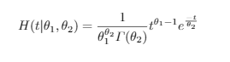
GA Gamma Encoding
Optimization based framework for encoding brain data
For BOLD (Blood Oxygen Level Dependent) Signal
where
S = Observed Signal
S(hat) = Predicted signal
B Ԑ {0,1}^t over time t (Binary Constraint for spikes)
a = Maximum number of spikes
Θ = Parameter to be optimised as part of the prediction model S(B,θ)
Optimization problem is solved by mixed integer Genetic Algorithm solver.

Slide 30
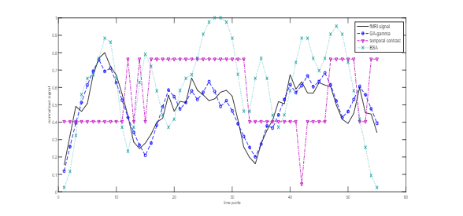
Comparison of GA Gamma, Temporal Contrast and BSA for fMRI data
Sengupta et al. (2015) “Framework for Knowledge Driven Optimisation Based Data Encoding for Brain Data Modelling Using Spiking Neural Network Architecture”

Slide 31
Open Questions
Simpler spike encoder for simple tasks v/s complex spike encoder for complex tasks
Should the focus be on advanced spike encoding or learning algorithms?
Should a spike encoder replicate biology or be inspired by biology?
What are some aspects which we can compromise/sacrifice while selecting a spike encoder?
What are the essential criteria for selecting a spike encoding method?

